Slide 1

Deployment Document
<CUSTOMER> <APPLICATION>
<DATE>

Slide 2
Contents
Contacts
Project Documentation
Access
Architecture
Application Demo
Technical Overview

Slide 3
Contacts
<NAME>
<ROLE>
<NAME>
<ROLE>
<NAME>
<ROLE>
<email>@<domain>
<email>@<domain>
<email@<domain>
<TEL>
<TEL>
<TEL>

Slide 4
Business Context
Project KickOff | link here | Project setup, delivery approach and timelines
Design/Research Docs | link here | Project ultimate goal, Personas, Process, UX and UI
Project Backlog* | link here | Initiation, Backlog planning over sprint development and solution release

Slide 5
Demo’s
Sprint 1 Demo | link here | Present first Sprint achievements
Sprint 2 Demo | link here | Present second Sprint achievements - Final demo

Slide 6
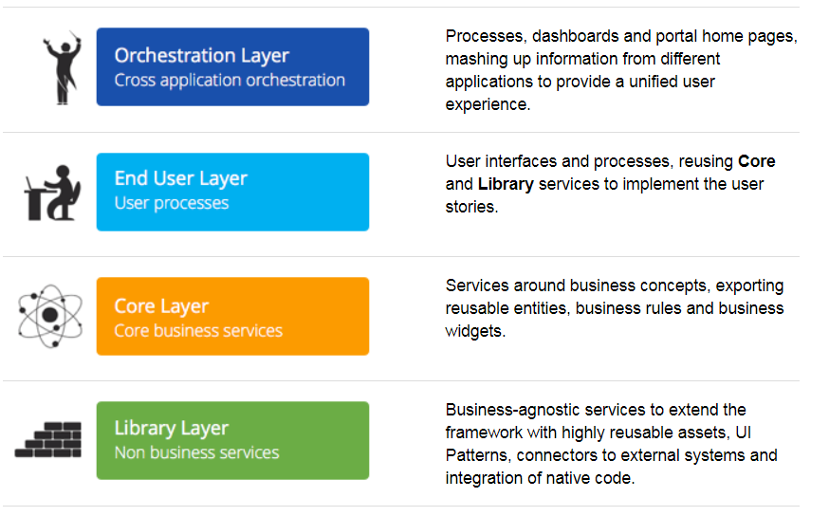
4LC - 4 Layer Canvas 1/2

Slide 7
4LC - 4 Layer Canvas 2/2
Knowledge base information
4LC - 4 Layer Canvas
Apply 4LC
Validate Architecture
Rules of an application
OutSystems Architecture overview
Webinar
Mileage and Expenses App

Slide 8
Architecture (applications) 1/2
<INSERT IMAGE OF APPLICATION ARCHITECTURE – DISCOVERY>
Mileage and Expenses App

Slide 9
Architecture (applications) 2/2
Application | Short Description
<Application name> | <description>
<Add rows for other applications>
Mileage and Expenses App

Slide 10
Architecture (modules) 1/3
<INSERT IMAGE OF MODULE ARCHITECTURE – DISCOVERY>
Mileage and Expenses App

Slide 11
Architecture (modules) 2/X
Module | Short Description
<Name of module> | <Short description>
Mileage and Expenses App

Slide 12
Architecture (modules) 3/X
Module | Short Description
<Name of module> | <Short description>
Mileage and Expenses App

Slide 13
Data Model (1/<X>)
<MODEL/ENTITY>
<INSERT IMAGE OF ERD / DATABASE MODELS>
Mileage and Expenses App

Slide 14
Application Access
Platform | Address
Lifetime | https://lgss-lt.outsystemsenterprise.com
Environments
Development | https://lgss-dev.outsystemsenterprise.com
Quality | https://lgss-tst.outsystemsenterprise.com
Production | https://forms.lgss.co.uk or https://cccapps.cambridgeshire.gov.uk
Mileage and Expenses App

Slide 15
Application User roles
All registered User will assume by default the X user role.
<Describe user roles and functions/access>
Mileage and Expenses App

Slide 16
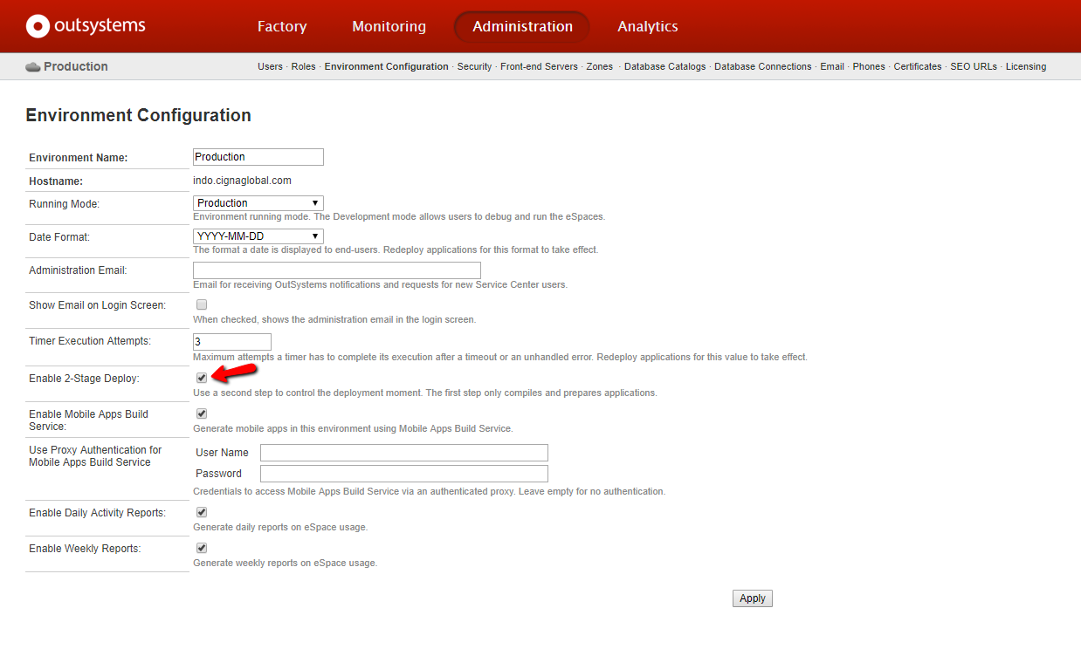
Deployment & Configuration
2-Stage deployment
2-Stage Deploy allows the control of the deployment moment.
Stage 1 compiles the application code, generates SQL scripts, and uploads binaries to the destination environment (without impact on running applications).
Stage 2 runs the SQL scripts to update the database and changes the running version of the application in the application server. These two stages can be executed separately, as the process halts and requires confirmation before starting stage 2.
1) Access Production’s Service Center
https://lgss.outsystemsenterprise.com/Servicecenter
2) Enable 2-Stage Deploy
Reference: Helptext

Slide 17
Production Deployment script
Deployment script (1/2)
Access Lifetime and select Applications from the top menu bar
Select Deploy (between the TST and Production environments)
Select Deploy individually for the following applications:
<main-application>
<application-dependency-1> etc…

Slide 18
Production Deployment script
Deployment script (2/2)
Select Validate Now
When validation is complete, select Continue
Include Deployment Notes with the deployment template
Select Deploy Now
…<anything else>

Slide 19
Production Deployment script
Bootstrap script
Access Service Center in https://forms.lgss.co.uk/ServiceCenter
Go to Factory in top menu bar
Select tab eSpaces, <…explain how to run any bootstrap timers>

Slide 20
Production Deployment script
Configuring Site Properties (1/X)
Access Service Center in https://lgss.outsystemsenterprise.com/ServiceCenter
Go to Factory in top menu bar
Select tab eSpaces, <explain each module that contains site properties that need setting>

Slide 21
Backoffice Management
<Describe any admin / support functionality>

Slide 22
Best Practices Patterns and Rules
Knowledge base information
Best Practices
Best Practices With Timers
Top Fails
Mileage and Expenses App

Slide 23
Done.

